Slide 1


INTERNET AND MOBILE
PROGRAMMING
DR VALERY

Slide 2
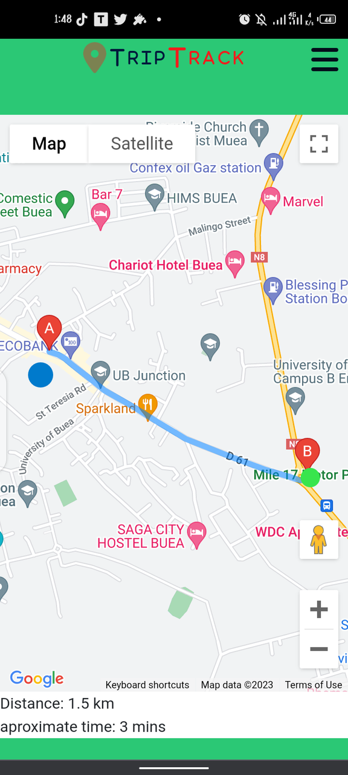
TRIPTRACK
Smarter Travel,
Smoother Commutes
Enhancing Public Transport Experiences

Slide 3

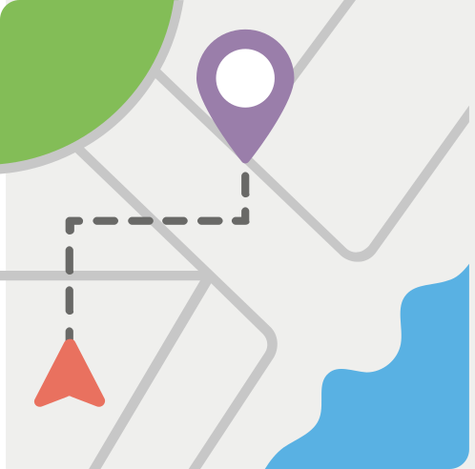


TRIPTRACK OVERVIEW
TRIPTRACK FUNCTIONALITIES
Maximizes fuel efficiency
Enhances user experience in public transport
Real-time passenger tracking
Optimized routes for efficient transportation
Utilizes advanced technologies for reliability
Benefits both drivers and passengers
ROUTE
OPTIMIZATION
FARE CALCULATION
TIME
ESTIMATE
PASSENGER
POSITION
DISTANCE
ESTIMATE

Slide 4

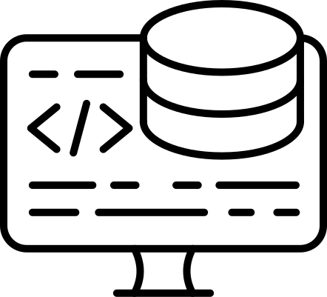
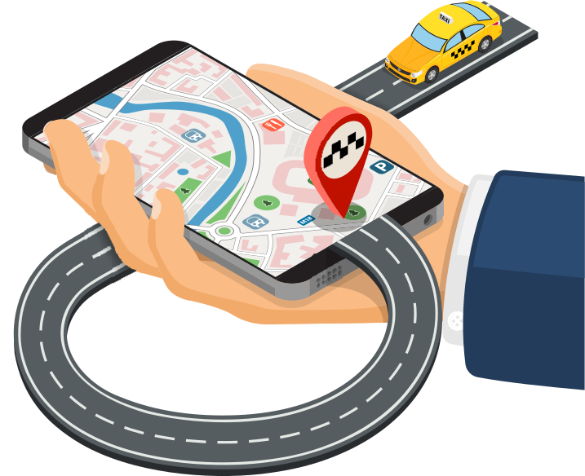
TRIPTRACK ARCHITECTURE
MOBILE APPLICATION
user-facing component of the system
permits drivers to see passengers
passengers display location
BACKEND SERVER
central hub for data processing
comunication between app and other components
MAPPING AND ROUTING SERVICE
mapping and routing algorithms
determine the most efficient path
provides turn-by-turn directions to the driver

Slide 5
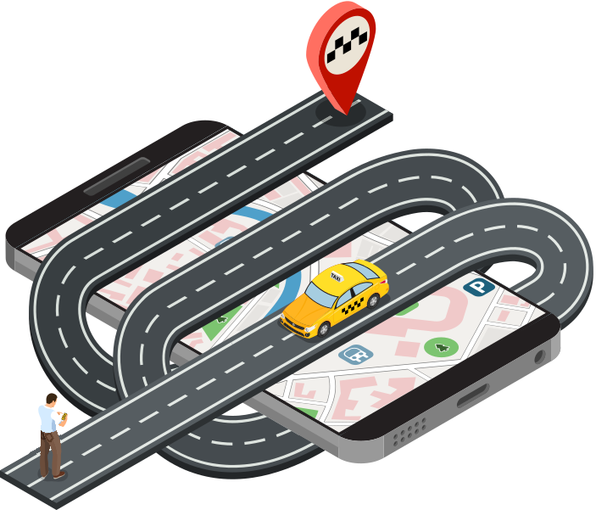

TRIPTRACK HARDWARE
SMARTPHONES SERVE AS THE PRIMARY HARDWARE COMPONENT FOR BOTH DRIVERS AND PASSENGERS

Slide 6
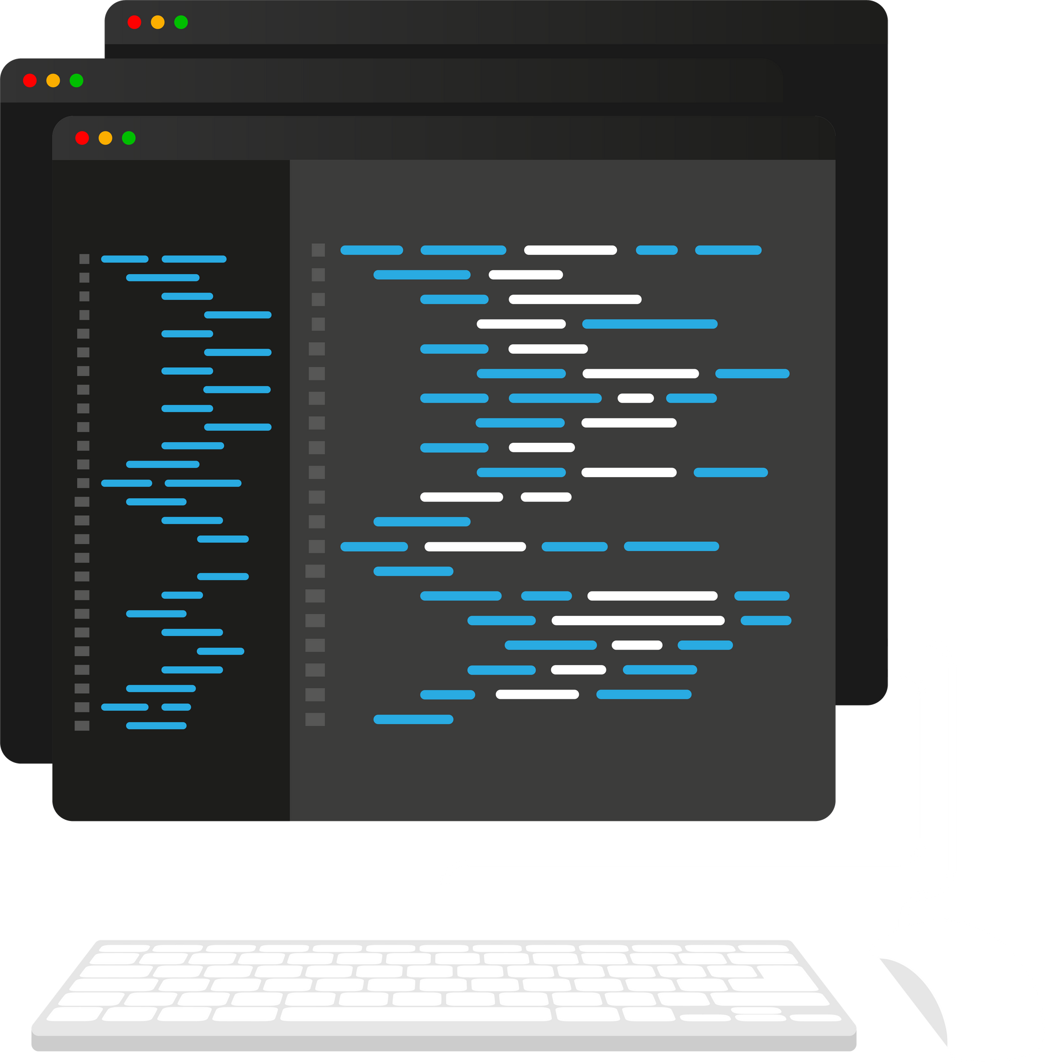





TRIPTRACK PROGRAMING LANGUAGES
Django framework
postgresql
javascript
&
css & html

Slide 7



TRIPTRACK STORING AND PROCESSING
DATA COLLECTION
real-time location data from drivers and passengers using GPS
Users interact with the mobile application to input information
DATA COLLECTION
Postgres sql
superbase
DATA SECURITY
encryption, access controls, and anonymization techniques
data protection regulations

Slide 8
Let's take a tour
INTO THE SYSTEM

Slide 9
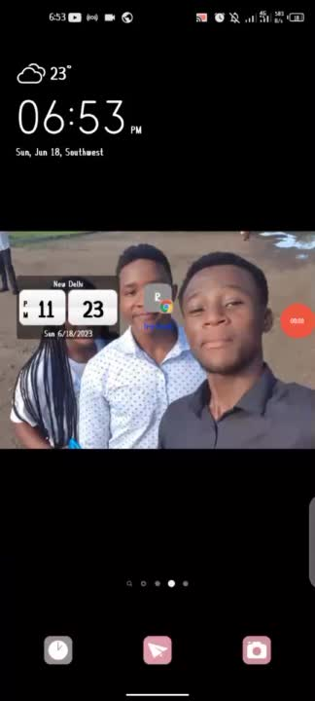
TRIPTRACK
LANDING PAGE

Slide 10
TRIPTRACK
USER SIGNUP

Slide 11
TRIPTRACK
PASSENGER DASHBOARD SIGNUP

Slide 12
TRIPTRACK
BECOME A DRIVER

Slide 13
TRIPTRACK
SEE VAROUSE PASSENGERS AND THIER DESTINATIONS

Slide 14



TRIPTRACK TESTING AND RESULTS
FUNCTIONAL TESTING RESULTS
real-time passenger tracking
route optimization
user interface interactions
PERFORMANCE TESTING RESULTS
response time
scalability
efficiency under various load conditions
USER FEEDBACK AND SATISFACTION
mapping and routing algorithms
determine the most efficient path
provides turn-by-turn directions to the driver

Slide 15


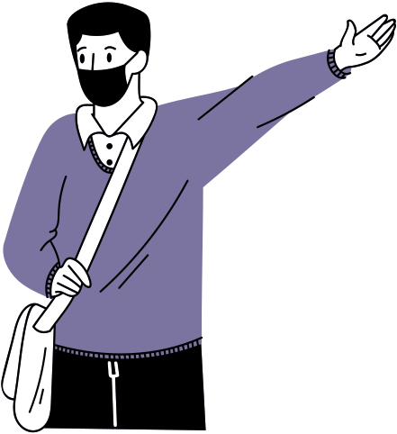


TRIPTRACK BENEFITS AND IMPACT
fuel Consumption
Can cause traffic
less time looking for a ride
Help users with lack of sense of direction in unknon areas

Slide 16



TRIPTRACK FUTURE ENHANCEMENT
Real time postion update
hiring drivers
providing more security measures for our system
Enable various driver locations on map
Help users with lack of sense of direction in unknon areas

Slide 17





CONCLUSION
THE PASSENGER POSITIONING SYSTEM AIMS AT IMPROVING MOBILITY IN THE COMMUNITY
TRIPTRACK TEAM

Slide 18
AKNOWLEDGEMENT
TRIPTRACK
KINDLY THANK
DR NKEMENY VALERY

Slide 19
THANK YOU

